Slide 1

Layout Managers
Session 10

Slide 2
Review
An Applet is a Java program that can be executed with the help of a Java enabled browser.
Every user-defined applet must extend the java.applet.Applet class.
A user defined applet inherits all the methods of Applet class.
<applet>..</applet> tags are used within a HTML file to embed a class file.
The default layout for an applet is FlowLayout.
Images can be drawn on an applet by means of the paint(), getImage() and drawImage() methods.
Whenever the user performs an action such as moving the mouse, pressing a key, releasing the key and so on, an event is generated. We can make use of event handler classes and interfaces to handle these events.

Slide 3
Review Contd…
Event handling in applets in the simplest form can be handled by overriding the mouseDown( ), mouseUp( ) , and mouseDrag( ) methods.
The Graphics class is used to draw objects like text , lines ovals and arcs on the screen.
The Font class is used to make text look attractive in the output of a Java program.
The FontMetrics class is used to obtain information about a Font.
GraphicsEnvironment class has methods to get information about the available fonts in the system.
The Color class is used to add colors to an application or applet.

Slide 4
Objectives
Define and identify the functions of a Layout Manager
List the types of Layouts
Explain the applications of layout managers
Discuss the following layouts:
  FlowLayout
  BoxLayout
  BorderLayout
  GridLayout
  CardLayout
  GridBagLayout
  SpringLayout

Slide 5
Layout Manager
Screen components on a user interface may be arranged in various ways.
Each of these ways could be referred to as layout of components.
To manage these layouts, there are layout managers.
Layout managers come into picture whenever the screen has to be resized or any item on the screen has to be redrawn.

Slide 6
Types of Layouts
The AWT provides a group of classes known as layout managers, that handle the layout management
Different types of layouts include :
  FlowLayout
  BoxLayout
  BorderLayout
  CardLayout
  GridLayout
  GridBagLayout
  SpringLayout

Slide 7
Applications of Layout Managers
Each layout manager has its own particular use
  For displaying a few components of same size in rows and columns, the GridLayout would be appropriate
  To display a component in maximum possible space, a choice between BorderLayout and GridBagLayout has to be made.

Slide 8
How to set layouts?
When a component is first created, it uses its default layout manager.
  Default layout of an applet is FlowLayout
All components are placed in a container and arranged according to the associated layout manager.
A new layout manager can be set using the setLayout() method.

Slide 9
FlowLayout Manager
Default layout for applets and panels
Components are arranged serially from upper left corner to bottom right corner
Constructors for the FlowLayout are :
  FlowLayout mylayout = new FlowLayout();
  FlowLayout exLayout = new FlowLayout(FlowLayout.TRAILING);
  // alignment specified

Slide 10
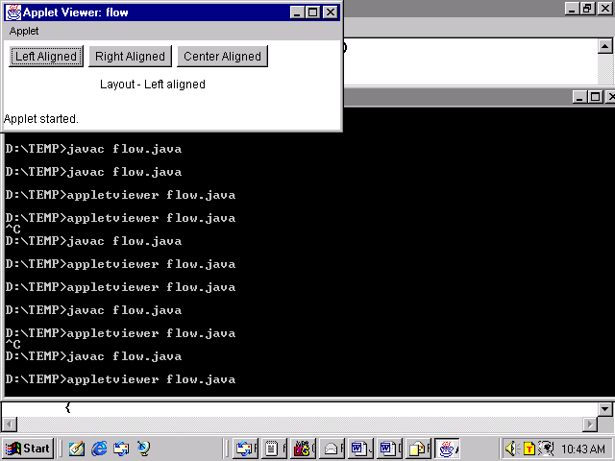
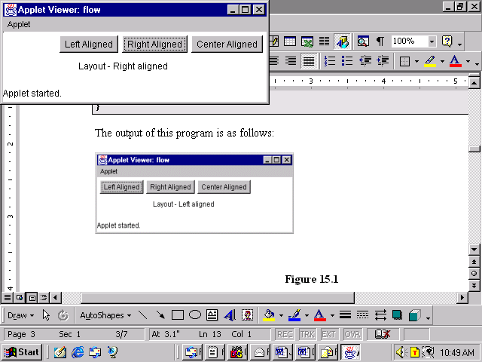
FlowLayout Manager Contd…
Flow Layout – Left and Right Aligned

Slide 11
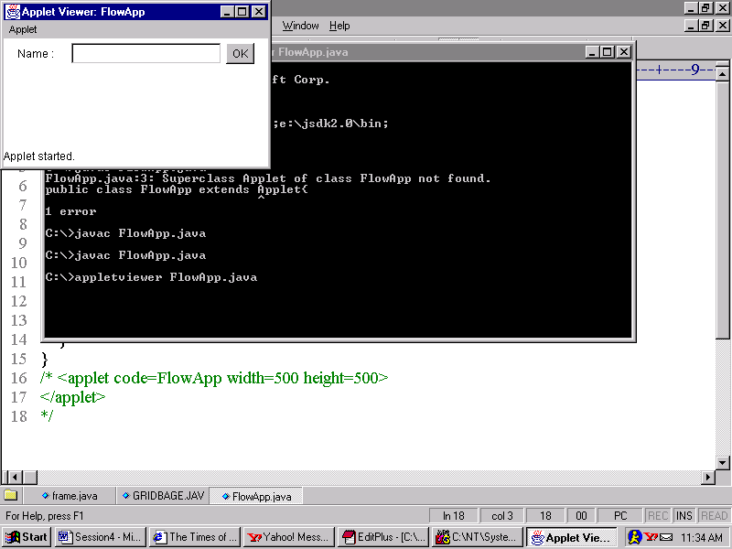
Example
/*
<applet code=FlowApp width=500 height=500>
</applet>
*/
import java.awt.*;
import java.applet.*;
public class FlowApp extends Applet
{
public void init()
{
TextField txtName = new TextField(20);
Label lblName = new Label("Name:");
Button ok = new Button("OK");
add(lblName);
add(txtName);
add(ok);
}
}
Output

Slide 12
BoxLayout Manager
The components can be stacked one on top of each other or it can be placed in rows
BoxLayout respects each component’s maximum size and X/Y alignment
If the container is wide then the components are made as wide as the container
Alignments for components are specified by using the following keywords: Component.LEFT_ALIGNMENT, Component. CENTER_ALIGNMENT, Component.RIGHT_ALIGNMENT

Slide 13
BoxLayout Manager Contd…
Box class has a nested class called Box.Filler class which adds the invisible components.
Rigid Area is used to add extra spaces between components.
Glue can be used to remove the extra spaces between the components.

Slide 14
Example
import java.awt.*;
import javax.swing.*;
public class BoxDemo
{
public static void addComponentsToPane(Container pane)
{
//PAGE_AXIS stands for top to bottom arrangement and LINE-
//AXIS stands for left to right
pane.setLayout(new BoxLayout(pane, BoxLayout.PAGE_AXIS));
addAButton("Button One", pane);
addAButton("Button Two", pane);
addAButton("Button Three", pane);
addAButton("Very Long Button Four", pane);
addAButton("Five", pane);
}
private static void addAButton(String text, Container con)
{
JButton but = new JButton(text);
but.setAlignmentX(Component.CENTER_ALIGNMENT);
con.add(but);
}
public static void main(String arg[])
{
JFrame objFrame = new JFrame("BoxLayoutDemo");
objFrame.setDefaultCloseOperation(JFrame.EXIT_ON_CLOSE);
addComponentsToPane(objFrame.getContentPane());
objFrame.pack();
objFrame.setVisible(true);
}
}

Slide 15
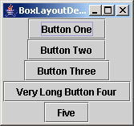
Example Contd…
Output

Slide 16
BorderLayout Manager
Default layout manager for objects of type Window, Frame and Dialog
Components are assigned to North, South, East, West, or Center position of the container using this layout

Slide 17
BorderLayout Manager Contd…
  Constant values which enables the positioning of the components in BorderLayout are:
    PAGE_START: corresponds to the top of the container
    LINE_END: corresponds to the right of the container
    PAGE_END: corresponds to the bottom of the container
    LINE_START: corresponds to the left of the container
    LINE_CENTER: corresponds to the center of the container

Slide 18
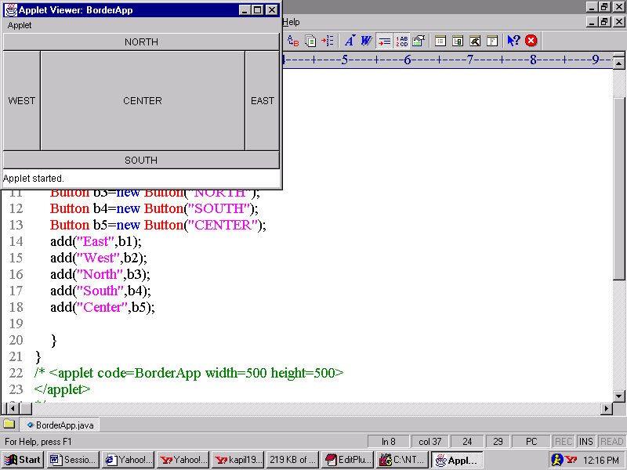
Example
/*<applet code = BorderApp width =500 height = 500>
</applet>
*/
import java.awt.*;
import java.applet.*;
public class BorderApp extends Applet
{
public void init()
{
setLayout(new BorderLayout());
Button best = new Button("EAST");
Button bwest = new Button("WEST");
Button bnorth = new Button("NORTH");
Button bsouth = new Button("SOUTH");
Button bcentre = new Button("CENTER");
add(best, BorderLayout.LINE_END);
add(bwest, BorderLayout.LINE_START);
add(bnorth, BorderLayout.PAGE_START);
add(bsouth, BorderLayout.PAGE_END);
add(bcentre, BorderLayout.CENTER);
}
}
Output

Slide 19
GridLayout Manager
Helps to divide the container area into a rectangular grid
Components are arranged in rows and columns
Used when all the components are of same size
One of the constructors of GridLayout is as follows:
  GridLayout g1= new GridLayout(4,3);
  (4 represents the number of rows and 3 the number of columns)

Slide 20
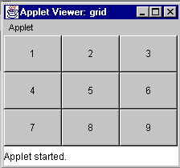
GridLayout Appearance

Slide 21
GridBagLayout Manager
Components need not be of same size
Components are arranged in rows and columns
Order of placing the components is not from top-to-bottom or left-to-right
A container can be set to GridBagLayout using the following syntax:
    GridBagLayout gb = new GridBagLayout();
    ContainerName.setLayout(gb);

Slide 22
GridBagLayout Manager Contd…
To use this layout, information must be provided on the size and layout of each component.
The class GridBagConstraints holds all the information required by the class GridBagLayout to position and size each component.
The GridBagConstraints class can be thought of as a helper class to GridBagLayout.

Slide 23
GridBagLayout Manager Contd…
List of member variable of the class GridBagConstraints :
  weightx, weighty: specifies space distribution
  gridwidth, gridheight: specifies number of cells across or down in the display area of a component
  ipadx, ipady: specifies by what amount to change the minimum height and width of a component

Slide 24
GridBagLayout Manager Contd…
List of member variable of the class GridBagConstraints:
  Anchor: specifies the location of components
  gridx, gridy: specifies in which cell to keep the component
  Fill: specifies how a component fills a cell if the cell is larger than the component
  Insets: specifies the gap between the components on the top, bottom, left and right

Slide 25
Example
/*<applet code= MyGridBag width = 500 height = 500>
</applet>
*/
import java.awt.*;
import java.applet.Applet;
public class MyGridBag extends Applet
{
TextArea ObjTa;
TextField ObjTf;
Button butta, buttf;
CheckboxGroup cbg;
Checkbox cbbold,cbitalic,cbplain,cbboth;
GridBagLayout gb;
GridBagConstraints gbc;
public void init()
{
gb = new GridBagLayout();
setLayout(gb);
gbc = new GridBagConstraints();
ObjTa = new TextArea("Textarea ",5,10);
ObjTf = new TextField("enter your name");
butta = new Button("TextArea");
buttf = new Button("TextField");
cbg = new CheckboxGroup();
cbbold = new Checkbox("Bold",cbg,false);
cbitalic = new Checkbox("Italic",cbg,false);
cbplain = new Checkbox("Plain",cbg,false);
cbboth = new Checkbox("Bold/Italic",cbg,true);
gbc.fill = GridBagConstraints.BOTH;
addComponent(ObjTa,0,0,4,1);
gbc.fill = GridBagConstraints.HORIZONTAL;
addComponent(butta,0,1,1,1);
gbc.fill = GridBagConstraints.HORIZONTAL;
addComponent(buttf,0,2,1,1);
gbc.fill = GridBagConstraints.HORIZONTAL;
addComponent(cbbold,2,1,1,1);
gbc.fill = GridBagConstraints.HORIZONTAL;
addComponent(cbitalic,2,2,1,1);
gbc.fill = GridBagConstraints.HORIZONTAL;
addComponent(cbplain,3,1,1,1);

Slide 26
Example Contd…
gbc.fill = GridBagConstraints.HORIZONTAL;
addComponent(cbboth,3,2,1,1);
gbc.fill = GridBagConstraints.HORIZONTAL;
addComponent(ObjTf,4,0,1,3);
}
public void addComponent(Component comp, int row, int col, int nrow, int ncol)
{
gbc.gridx = col;
gbc.gridy = row;
gbc.gridwidth = ncol;
gbc.gridheight = nrow;
gb.setConstraints(comp,gbc);
add(comp);
}
}

Slide 27
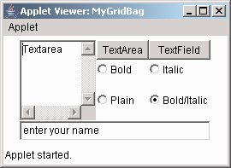
Example Contd…
Output

Slide 28
CardLayout Manager
Can store a stack of several layouts
Each layout is like a card in a deck
The cards are stored usually in a Panel object
Used whenever we need number of panels each with a different layout to be displayed one by one
A main panel will contain these panels

Slide 29
Example
/*
<applet code = "MyCardDemo" height = 300 width = 300>
</applet>
*/
import java.awt.*;
import java.awt.event.*;
import java.applet.*;
public class MyCardDemo extends Applet implements
ActionListener, MouseListener
{
Checkbox nov, fic, autobio, story, swim, runn;
Panel hobcards;
CardLayout cardlo;
Button reading, playing;
CheckboxGroup cbg;
public void init()
{
reading = new Button("Reading");
playing = new Button ("Games");
add(reading);
add(playing);
cardlo = new CardLayout();
hobcards = new Panel(); // main panel
// sets the layout of the main panel to card layout
hobcards.setLayout(cardlo);
cbg = new CheckboxGroup();
nov = new Checkbox("NOVELS", cbg, true);
fic = new Checkbox("FICTIONS", cbg, false);
autobio = new Checkbox("AUTOBIOGRAPHY", cbg, false);
story = new Checkbox("STORIES", cbg, false);
swim = new Checkbox("SWIMMING", false);
runn = new Checkbox("RUNNING", false);

Slide 30
Example Contd…
public void mousePressed(MouseEvent m)
{
cardlo.next(hobcards);
}
public void mouseClicked(MouseEvent m)
{}
public void mouseEntered(MouseEvent m)
{}
public void mouseExited(MouseEvent m)
{}
public void mouseReleased(MouseEvent m)
{}
public void actionPerformed(ActionEvent ae)
{
if(ae.getSource() == reading)
{
cardlo.show(hobcards,"READING" );
}
else
{
cardlo.show(hobcards,"PLAYING");
}
}
}
// adding radio buttons to the reading card panel – first deck
Panel readpan = new Panel();
readpan.setLayout(new GridLayout(2,2));
readpan.add(nov);
readpan.add(fic);
readpan.add(autobio);
readpan.add(story);
// adding checkbox to the playing card panel – Second deck
Panel playpan = new Panel();
playpan.add(swim);
playpan.add(runn);
// adding the two panels to the card deck panel
hobcards.add(readpan,"READING");
hobcards.add(playpan,"PLAYING");
// adding cards to the main applet pannel
add(hobcards);
// register to receive action events
reading.addActionListener(this);
playing.addActionListener(this);
// registering mouse movements
addMouseListener(this);
}

Slide 31
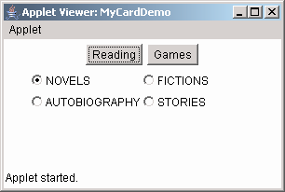
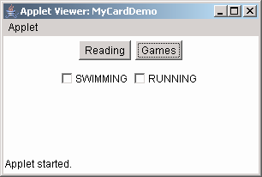
Example (Output) Contd…
Output

Slide 32
SpringLayout Manager
SpringLayout Manager was incorporated in Java 1.4.
This layout defines relationship between the edges of components.
The springs associated with each component are collected into a SpringLayout.Constraints object.

Slide 33
Example
import java.awt.*;
import javax.swing.*;
public class SpringDemoAppl
{
public static void show()
{
JFrame fobj = new JFrame("SpringLayoutDemo");
fobj.setDefaultCloseOperation(JFrame.EXIT_ON_CLOSE);
Container contentPane = fobj.getContentPane();
SpringLayout layout = new SpringLayout();
contentPane.setLayout(layout);
JLabel label = new JLabel("Label: ");
JTextField textField = new JTextField("Text field", 15);
contentPane.add(label);
contentPane.add(textField);
layout.putConstraint(SpringLayout.WEST, label, 5, SpringLayout.WEST, contentPane);
layout.putConstraint(SpringLayout.NORTH, label, 5, SpringLayout.NORTH, contentPane);
layout.putConstraint(SpringLayout.WEST, textField, 5, SpringLayout.EAST, label);
layout.putConstraint(SpringLayout.NORTH, textField, 5, SpringLayout.NORTH, contentPane);
layout.putConstraint(SpringLayout.EAST,contentPane,5, SpringLayout.EAST, textField);
layout.putConstraint(SpringLayout.SOUTH,contentPane,5, SpringLayout.SOUTH, textField);
fobj.pack();
fobj.setVisible(true);
}
public static void main(String arg[])
{
show();
}
}

Slide 34

Example Contd…
Output

Slide 35
Summary
The layout manager class provides a means for controlling the physical layout of GUI elements.
The different types of layouts are as follows:
  FlowLayout
  BoxLayout
  BorderLayout
  CardLayout
  GridLayout
  GridBagLayout
A layout is set with the method setLayout()
The FlowLayout is the default Layout Manager for applets and panels.

Slide 36
Summary Contd…
The BoxLayout is a full featured version of FlowLayout.
The BorderLayout arranges components in the ‘North’, ‘South’, ‘East’, ‘West’, and ‘Center’ of a container.
The GridLayout places components in rows and columns. All components are of the same size.
The CardLayout places components on top of each other. It creates a stack of several components, usually panels.
The GridBagLayout places components more precisely than any other layout manager. The only difference is that the components need not be of the same size and can be placed in any row or column.
SpringLayout Manager was incorporated in Java 1.4 and defines relationship between the edges of components.

